Slide 1
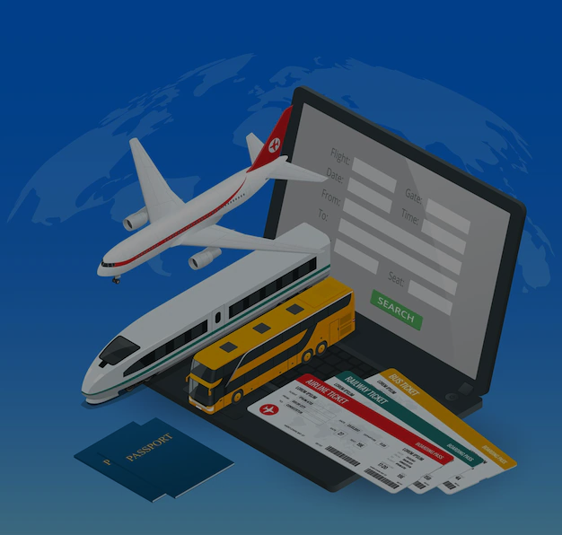
ONLINE TRAVELLING SYSTEM
Name:
Section:
University:
Roll No:
Mentor:

Slide 2
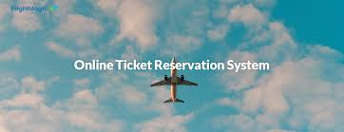
Introduction
An online travelling system is a piece of a software used for reservation management. It allows travel and hospitality businesses to accept bookings online and manage mobile and personal bookings in a better way.
This project is based on tickets booking management system.
This project have feature to book the cab also.
Basically this project help the user to book the tickets for the train and bus.

Slide 3

Problem Statement
This project aims to develop an online travel system, primarily focused on ticket booking, using C++.The system facilitates the booking of bus and train tickets, as well as cab reservations. This projects enables users to book tickets without any issues .

Slide 4
Methodology
Provided C++ code implement a Travelling system with functionalities for train booking, bus booking and cab booking.
It have two module:
User Management
Booking System
Online Travelling System
User Management
Booking System

Slide 5




User Management:
This module consists of Add new client, login client function and exit option.
Add new client function will take user name, Email ID and password for new users.
Login client function will ask for user name and password.
Last is exit option to escape form the program
User management
Add new client
Login client
Exit

Slide 6
Booking System:
This module consists of Train booking, Bus booking, Cab booking function and option to return to login screen.
Train booking further consists of 4 other functions.(installation, reservation, show and available).
Bus booking further consists of 4 other functions.(installation, reservation, show and available).
Cab booking take all required details and print the information on the screen.
4 option will take you back to login screen
Booking System
Train Booking
Bus Booking
Cab Booking
Return

Slide 7
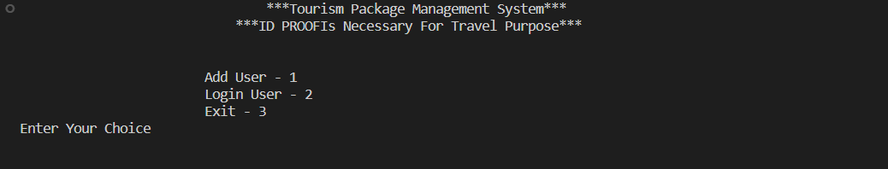
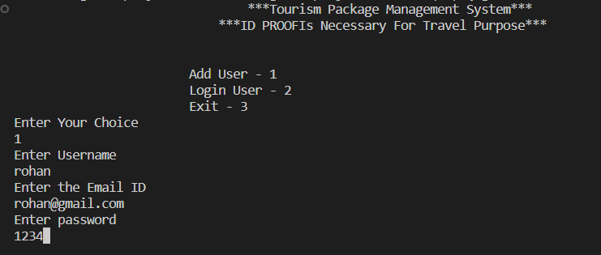
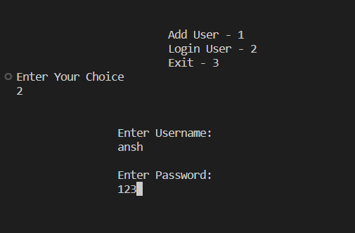
Results
First screen of the project
If first option is choice then this screen shown.
If second option is choice then this screen shown.
If third option is choice then you exit the program.

Slide 8
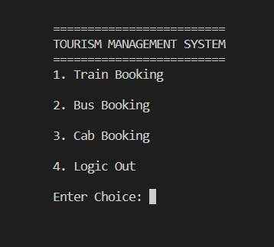
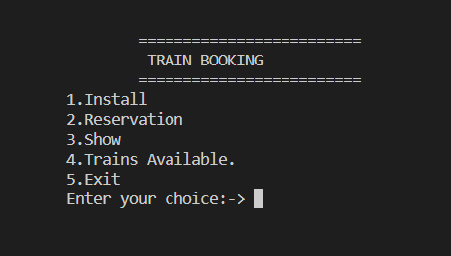
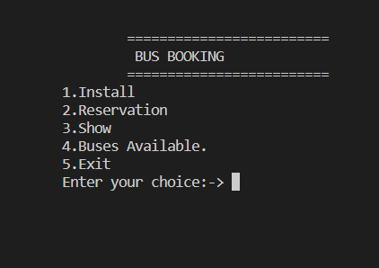
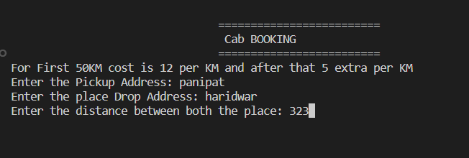
If you login successfully then this screen will be shown.
If you choice option 1 then this screen will be shown
If you choice option 2 then this screen will be shown
If you choice option 3 then this screen will be shown
If option 4 is selected then you will return to previous window.

Slide 9
Conclusion and Future Work
1-Conclusion
In the conclusion, the implementation of the online traveling system has proven to be significant milestone in streamlining booking operations and enhancing customer experiences. The comprehensive Testing and evaluation phases have validated the system’s functionalities, security measures, and compliance with regulatory standards.
2-Future Work
The current version of the online traveling system is simple and includes only the feature of booking tickets. In the future, we can enhance the code by introducing new features such as hotel booking, flight booking and many more, based on user demand.

Slide 10


